Slide 1
Vietnamese Sentiment Analysis
Capstone Project
Group 3
Phạm Văn Cường - 20194421
Nguyễn Việt Hoàng - 20194434
Hoàng Văn Khánh - 20194440
Phan Đức Thắng - 20194452
Phạm Việt Thành - 20194454

Slide 2
Introduction
In this project, we will build sentiment analysis systems with a Vietnamese Dataset. The dataset is called UIT-VSFC, which is released by Ho Chi Minh City University of Technology. The data is built from Vietnamese students’ feedback on various topics.
For the given dataset, we perform experiments with several neural networks architectures for sentiment analysis. The chosen models are as follow:
RNN (Recurrent Neural Networks).
LSTM (Long-Short Term Memory Networks).
Transformers.
BERT (Bidirectional Encoder Representations from Transformers).
With each model, we tried various configurations to see if the current solutions can be improved.

Slide 3
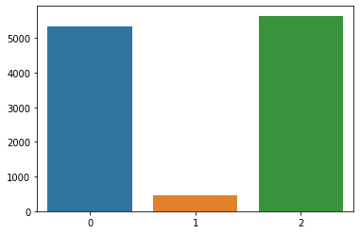
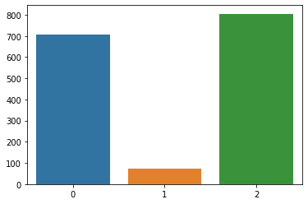
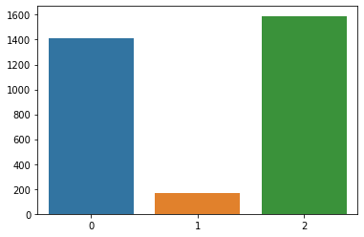
Data Overview: Imbalanced Dataset
Number of samples per class (train set)
Number of samples per class (dev set)
Number of samples per class (test set)

Slide 4
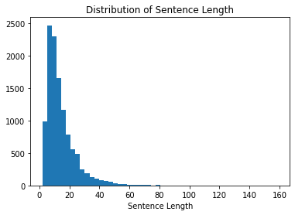
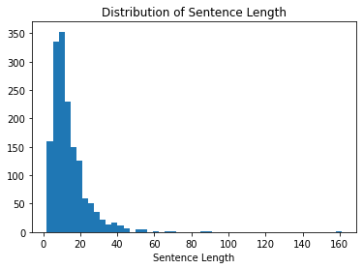
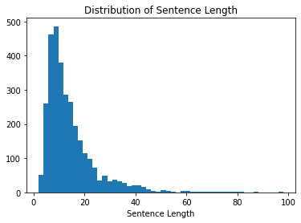
Data Overview: Sentence Length Distribution
Train Set
Dev Set
Test Set

Slide 5
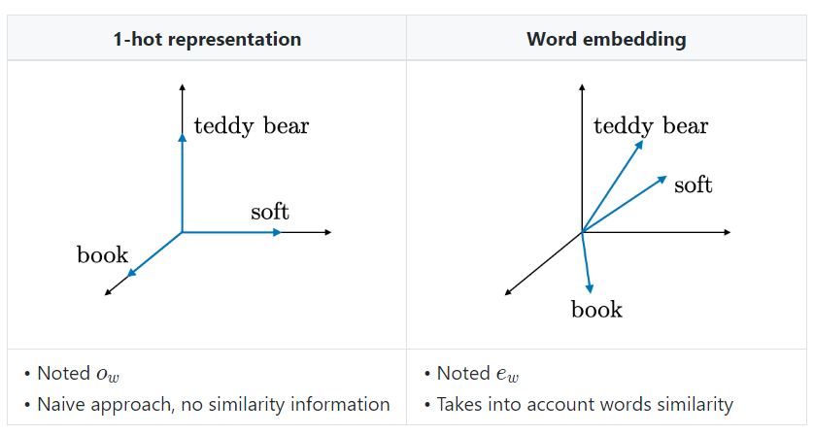
Preprocessing
We use these two main ways of representing data.
We added some special tokens:
“<name>”: human name
“<unknown>”: words in dev set and test set that don’t exist in training set.
“<pad>”: used for padding.
Punctuations (“!”, “?”, “.”,...) are not removed.

Slide 6
Preprocessing - Word segmentation
Words in Vietnamese can contain 1 or more syllables. For instance, a 6-syllable sentence “Tôi là một nghiên cứu viên” forms 4 words sentence “Tôi là một nghiên_cứu_viên”.
Because of this, applying word representations without any pre-processing can cause a degradation in the model performance.
In this project, we experiment with applying a word segmenter to the text before training to see if there is any performance improvement. RDRSegmenter from VnCoreNLP is the chosen word segmentation method.

Slide 7
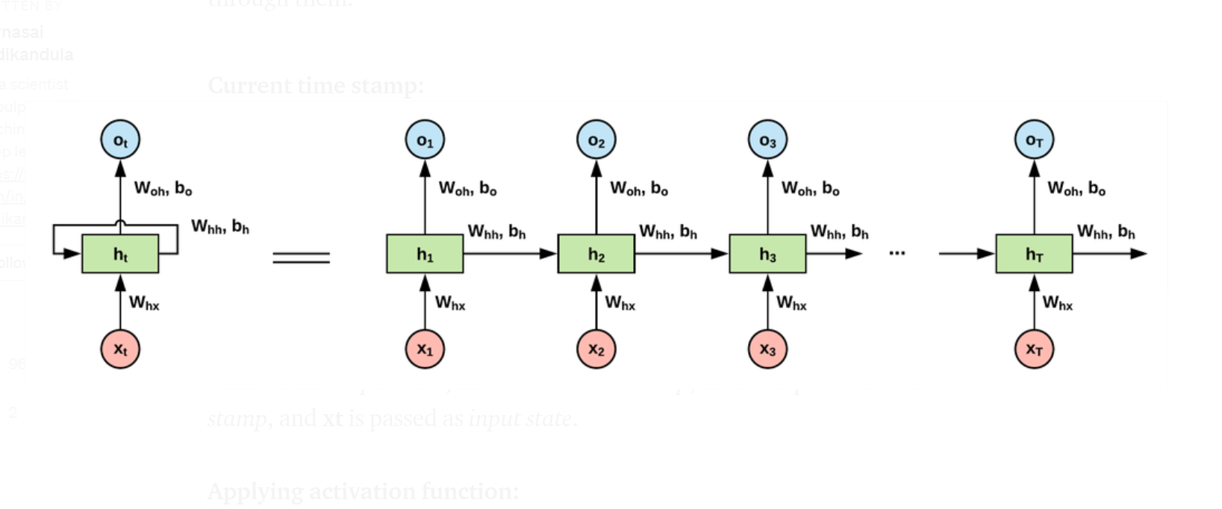
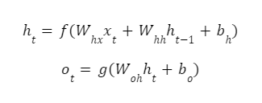
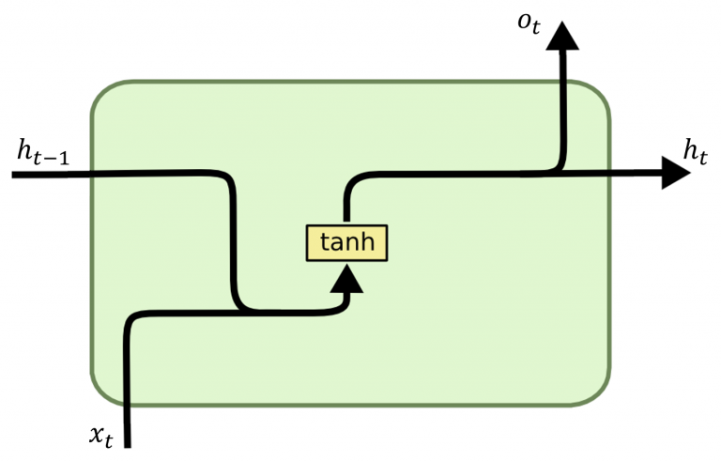
Recurrent Neural Network (RNN)
x_{t}: is the input data at timestep t. More specifically, the t^{th} word in the sentence in our case.
h_{t}: is the hidden state at timestep t.
o_{t}: is the output at timestep t.
W_{hx}, W_{hh}, W_{oh}, b_{h}, and b_{o}: are shared weights and biases as described in Fig 4.1.1.
f and g: are activation functions.

Slide 8
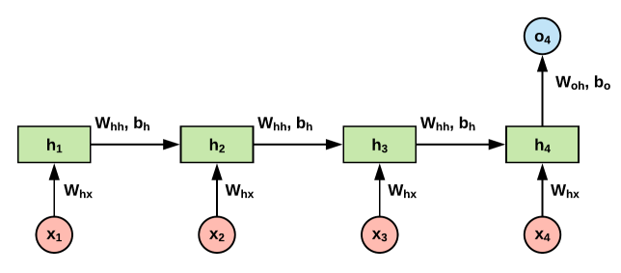
Recurrent Neural Network (RNN)
For our problem: We use the many-to-one RNN architecture. Only the last output is used to predict the label.

Slide 9
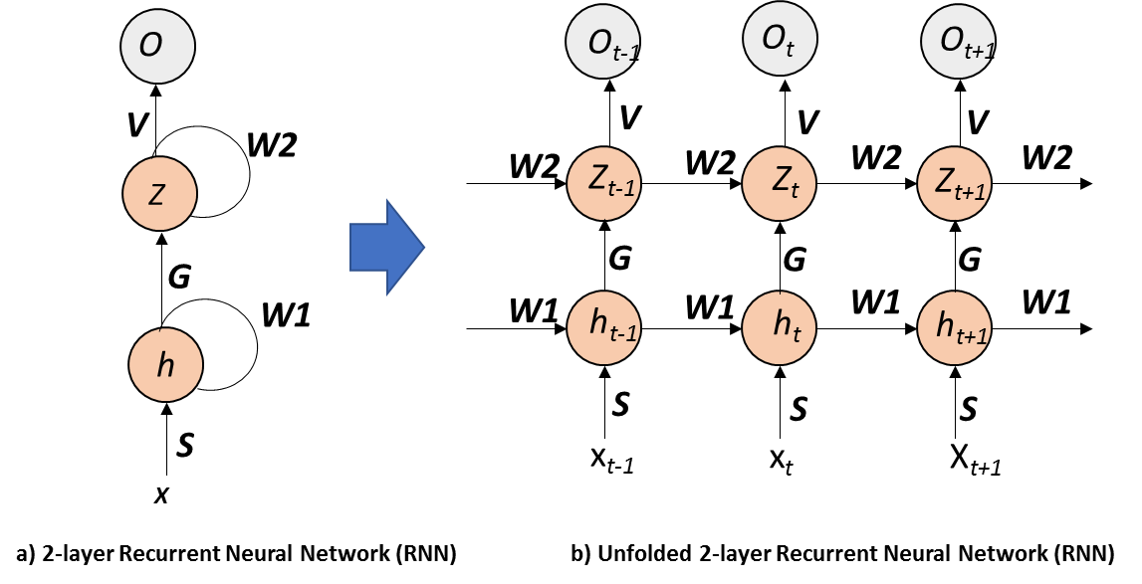
Recurrent Neural Network (RNN)
More layers can be added to increase the expressiveness of the model.
We use 3 layers RNN model.

Slide 10
RNN performance
No | Model | Hyper params tuning | Acc | F1 Score
 |  |  |  | Negative | Neutral | Positive | Weighted Avg
1 | 1 layer, one-hot | No | 88.31 | 88.94 | 42.03 | 91.66 | 88.16
2 | 1 layer, word embedding | No | 88.82 | 89.84 | 43.10 | 91.09 | 88.36
3 | 3 layers, one-hot | Yes | 90.59 | 91.77 | 46.51 | 93.08 | 90.35
4 | 3 layers, word-embedding | Yes | 90.84 | 92.03 | 42.52 | 93.60 | 90.54
5 | 3 layers, one-hot, word segmentation | Yes | 90.52 | 91.49 | 39.25 | 93.08 | 89.89
6 | 3 layers, word-embedding, word segmentation | Yes | 91.09 | 92.46 | 41.12 | 93.18 | 90.46
RNN performance on dev set with different configurations

Slide 11
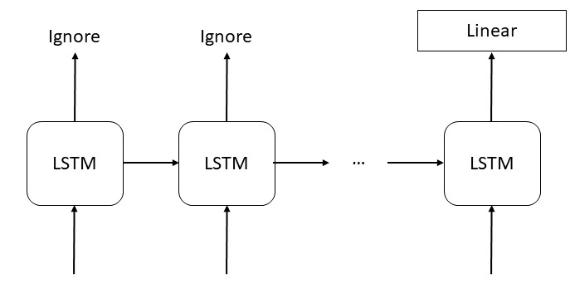
LSTM
The initial implementation is the classic many-to-one model.
However in this approach, this approach does not effectively utilize all informations of all words

Slide 12
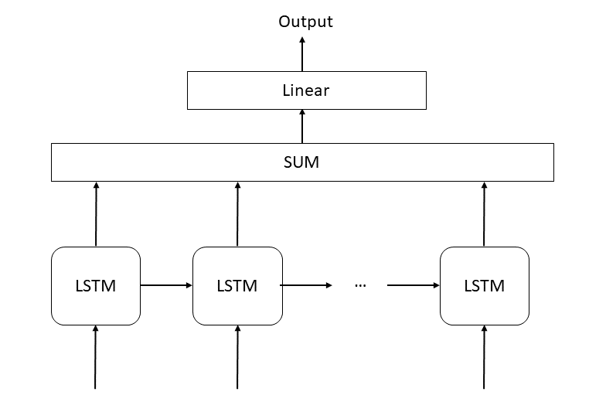
LSTM
Add all the output of LSTM cells to use the information from all the words in the sentence

Slide 13
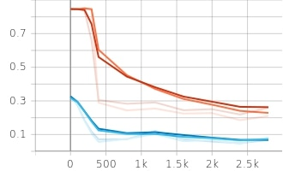
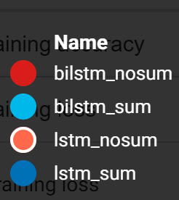
Sum vs No Sum
Models converge faster if use the sum of all outputs
Training Loss

Slide 14
Sum vs No Sum: Dev Results
Models | Accuracy | F1 Score
 |  | Negative | Neutral | Positive | Weighted Avg
1-directional, no sum output | 90.84 | 92.32 | 43.55 | 93.15 | 90.49
1-directional, sum output | 89.32 | 91.67 | 48.89 | 91.84 | 89.79
Bidirectional, no sum output | 89.83 | 91.55 | 0.00 | 92.31 | 87.71
Bidirectional, sum output | 89.96 | 92.20 | 52.97 | 92.30 | 90.44

Slide 15
Other hyperparameters: Dev Results
Non bidirectional
Sequence Length: 40
Embedding Layer: 500
 | Accuracy | F1 Score
 |  | Negative | Neutral | Positive | Weighted Avg
No word segmentation | 90.21 | 90.96 | 53.52 | 92.76 | 90.15
Word segmentation | 90.27 | 91.91 | 46.67 | 92.92 | 90.33

Slide 16
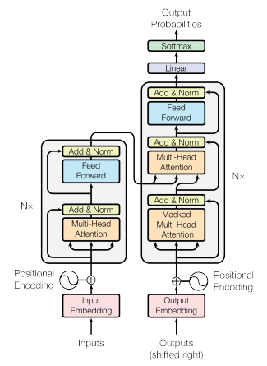


TRANSFORMER
Encoder-decoder structure
Scaled dot-product Attention
An attention function maps a query and a set of key-value pairs to and output.
Let Q the matrix of queries, K the matrix of keys, V the matrix of values, the matrix of output is calculated as:
Multi-Head Attention
The multi-head attention includes several parallel attention layers (heads):
Transformer by Vaswani et al. 2017

Slide 17

TRANSFORMER
Point-wise feed forward network
Each encoder/decoder layer contains a fully connected feed-forward network.
Consists of two linear transformations with a ReLU activation in between.
Embeddings
The input tokens and output tokens are converted into vectors of dimension d_{model} = 512.
Positional encoding
Add information about positions of the tokens in the sequence
Transformer by Vaswani et al. 2017

Slide 18
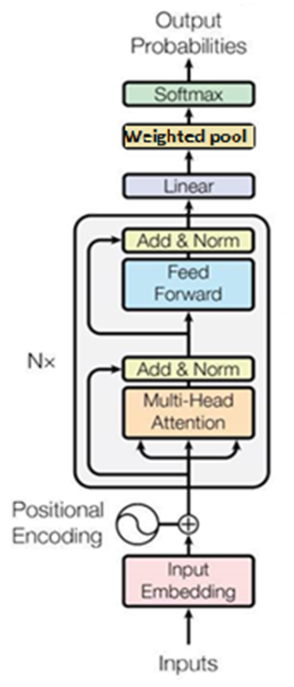
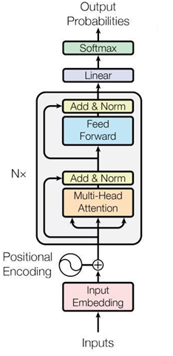
TRANSFORMER
Our model only contains encoder layers.
Linear-transformation and softmax function are used to convert the encoder output to either:
predicted token probabilities for Masked Language Model task, or
predicted sentiment probabilities for sentiment analysis task.
Hyperparameters (best value in bold):
Parameter | Values
Input/ output dimension | Number of tokens in train- data’s longest sentence.
Embedding dimension | 20; 40; 100; 200
Number of heads in multi-head attention | 1; 2; 4
Number of encoding layers | 1; 2; 4
Dimension of the feedforward network model in encoder layers | 20; 50; 200; 400
For Sentiment analysis task
For MLM task

Slide 19
TRANSFORMER
Preprocessing:
Word split vs word segmentation (e.g: “giáo viên” => [“giáo”, “viên”] or [“giáo_viên”])
Tokenizer (e.g: given a dictionary: {“giáo”: 1, “viên”: 2} , then “giáo viên” => [1,2])
Padding (e.g: given input dimension = 3, then “giáo viên” => [1,2,0])
Pretrain: Masked Language Modeling
Give the model a sentence and optimizing the weights in order to output the same sentence on the other side.
While the input and label sentence are essentially the same, the input sentence has some of its tokens masked.
Models performance:
Model No. | Data preprocessing | Pretrain | Valid acc. | Valid F1 | Test acc. | Test F1
1 | Word split, tokenized | No | 91.60 | 91.46 | 89.51 | 89.10
2 |  | Yes | 92.17 | 91.89 | 89.67 | 89.30
3 | Word segmented, tokenized | Yes | 92.23 | 92.04 | 89.89 | 89.44

Slide 20
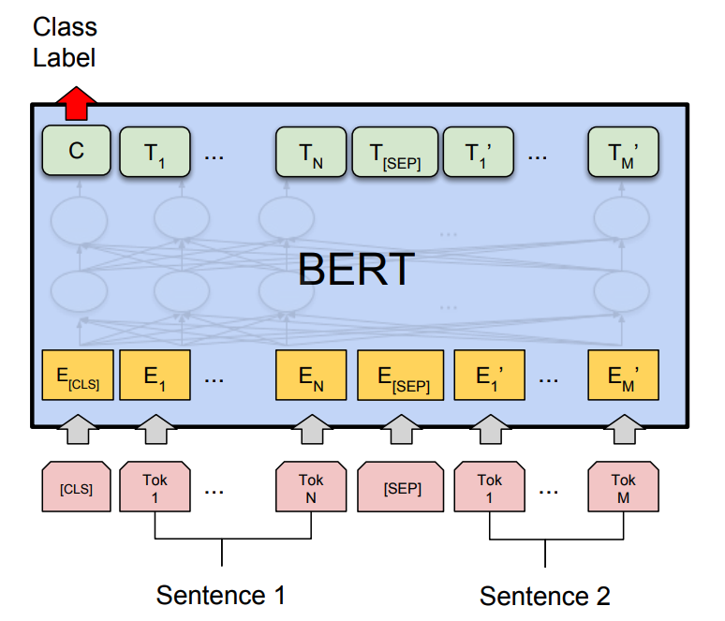
BERT
Architecture: Transformer encoders.
Model input: pair of sentences:
A sentence here is a segment of contiguous text sampled from the data rather than a true linguistic sentence.
A [SEP] token is placed at the end of each sentence.
A [CLS] token is placed before the first sentence.

Slide 21
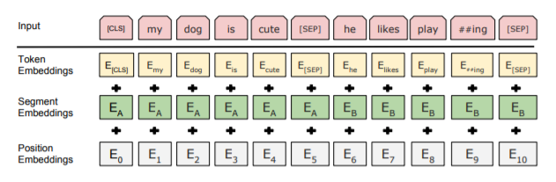
BERT
Token Embeddings. Wordpiece tokenizer.
Segment Embeddings. Binary numbers that tell which tokens belong to which sentences.
Positional Embeddings. Similar to Transformer’s.

Slide 22
BERT - Training objectives
Masked language modeling
A random sample of the tokens in the input is replaced with the [MASK] token.
Use Cross-Entropy loss for predicting the masked tokens.
Next sentence prediction
Predict if the 2 sentences is adjacent in the document.
Use the hidden state output of the [CLS] token, pass it through a binary classification loss.
RoBERTa
Dynamic Masking
Perform masking every time the model sees the sentence.
NSP Removal
Remove the NSP training objective.
RoBERTa for sentiment analysis
Append a linear layer on top with random initializations.

Slide 23
BERT - Results on dev set
Method |  | Dev set
Pretrained model | Word Segmentation | Accuracy | F1
 |  |  | Negative | Neutral | Positive | Weighted Avg
From scratch | no | 91.06 | - | - | - | 91.20
PhoBERT-base | no | 94.57 | 96.48 | 60.53 | 96.06 | 94.64
PhoBERT-base | yes | 95.51 | 96.85 | 68.22 | 96.48 | 95.36
PhoBERT-large | yes | 95.83 | 96.86 | 67.19 | 97.24 | 95.66

Slide 24
Final Results on Test Set
Model | Acc | F1 Score
 |  | Negative | Neutral | Positive | Weighted Avg
RNN | 89.23 | 90.77 | 29.63 | 91.85 | 88.09
LSTM | 89.01 | 90.94 | 42.81 | 91.70 | 88.78
Transformer | 89.89 | 91.63 | 44.85 | 92.18 | 89.44
BERT | 93.78 | 95.22 | 58.62 | 95.74 | 93.52

Slide 25
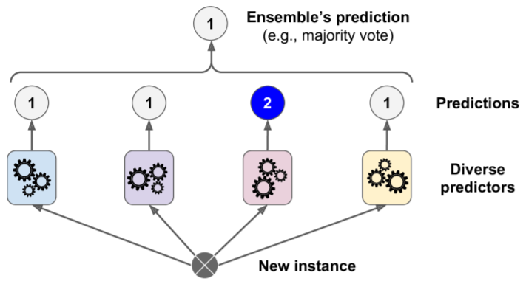
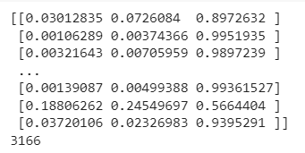
Ensemble learning
Idea: Combine the output of individual models into a single output of the ensemble.
Hard voting: Since our models’ accuracy is over 89% and Transformer is slightly higher than the others two models, we hope ensembling models will do a better result due to The law of large numbers. First, we argmax (axis=1) the output and then counter the major voting.

Slide 26
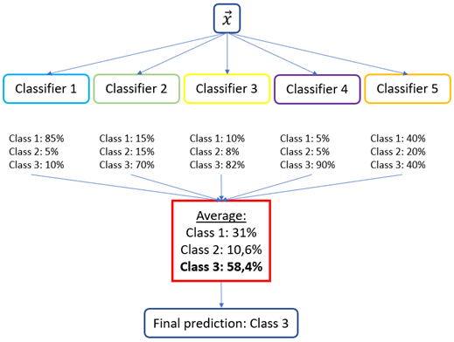
Ensemble learning
Soft voting:
- This strategy predicts the class label based on the argmax of the sums of the predicted probability of the individual estimators that make up the ensemble.
- Soft voting can improve on hard voting because it takes into account more information; it uses each classifier’s uncertainty in the final decision.

Slide 27
Ensemble performance on test set
Model | Word segmentation | Voting Strategy | Acc | F1 Score
 |  |  |  | Negative | Neutral | Positive | Weighted Avg
LSTM + RNN + Transformer | No | Soft voting | 90.05 | 91.77 | 44.02 | 92.24 | 89.49
 |  | Hard voting | 89.73 | 91.43 | 41.86 | 92.08 | 89.14
 | Yes | Soft voting | 90.37 | 91.91 | 44.09 | 92.66 | 89.77
 |  | Hard voting | 90.24 | 91.92 | 42.52 | 92.53 | 89.62
LSTM + RNN | No | Soft voting | 89.67 | 91.59 | 42.80 | 91.92 | 89.19
 | Yes |  | 90.05 | 92.01 | 41.35 | 92.35 | 89.51
RNN + Transformer | No | Soft voting | 89.96 | 91.42 | 45.04 | 92.34 | 89.44
 | Yes |  | 90.11 | 91.69 | 38.37 | 92.67 | 89.37
LSTM + Transformer | No | Soft voting | 90.15 | 91.90 | 46.98 | 92.38 | 89.77
 | Yes |  | 90.49 | 92.45 | 46.04 | 92.62 | 90.08

Slide 28
Further improvement on BERT
Model 1. Train without preprocessing the names, ie. keeping names as they are.
Model 2. Train with the data in which all names are removed.
Model 3. Train with the data in which all names are replaced with <name> tokens.
Model |  | Test set
 |  | Accuracy | F1 Score
 |  |  | Negative | Neutral | Positive | Weighted Avg
Model 1 |  | 93.52 | 95.24 | 59.73 | 95.14 | 93.32
Model 2 |  | 93.81 | 95.32 | 56.18 | 95.63 | 93.39
Model 3 |  | 94.00 | 95.72 | 61.33 | 95.52 | 93.82

Slide 29
BERT - Ensembling strategies
Model |  | Test set
 |  | Accuracy | F1 Score
 |  |  | Negative | Neutral | Positive | Weighted Avg
Model 3 (Previous best) |  | 94.00 | 95.72 | 61.33 | 95.52 | 93.82
Model 1 + Model 2 + Model 3 |  | 94.13 | 95.63 | 61.32 | 95.73 | 93.87
Model 1 + Model 3 |  | 94.09 | 95.71 | 61.86 | 95.59 | 93.86
Model 2 + Model 3 |  | 94.28 | 95.88 | 61.65 | 95.70 | 93.99

Slide 30
Results comparison to other papers
Model |  | Test set
 |  | F1 Score
 |  | Negative | Neutral | Positive | Weighted Avg
Our best model (BERT ensemble) |  | 95.88 | 61.65 | 95.70 | 93.99
Huy et al. VNU-HCM (2020) (BERT + CNN + BiLSTM + LSTM ensemble) |  | - | - | - | 92.79
UIT-VSFC paper by Kiet et al. VNU-HCM (2018) (MaxEnt) |  | 90.52 | 33.99 | 91.32 | 87.94

Slide 31
Conclusion
Future works
Using word segmentation improves every models.
By applying ensemble mechanism, the combination of 2 BERT configurations achieves the highest accuracy and weighted F1 score.
Achieve equivalent or better results on other Vietnamese sentiment analysis benchmarks.
Experiment with adding in-domain pre-training data for Transformer and BERT.

Slide 32
Thank you!
References
UIT-VSFC: Vietnamese Students’ Feedback Corpus for Sentiment Analysis
A Simple and Efficient Ensemble Classifier Combining Multiple Neural Network Models on Social Media Datasets in Vietnamese
Recurrent Neural Networks cheatsheet - CS 230 - Deep Learning - Stanford
Fundamentals of Recurrent Neural Network (RNN) and Long Short-Term Memory (LSTM) Network
https://www.coursera.org/learn/nlp-sequence-models
[1706.03762] Attention Is All You Need (arxiv.org)
BERT: Pre-training of Deep Bidirectional Transformers for Language Understanding
RoBERTa: A Robustly Optimized BERT Pretraining Approach
PhoBERT: Pre-trained language models for Vietnamese

